Slide 1
Topic 6:Theory of Production and Business Organization

Slide 2
CHAPTER OUTLINE
Theory of Production
Basic Concepts
The Production Function
Total, Average, and Marginal Product
The Law of Diminishing Returns
Returns to Scale
Short Run and Long Run
Technological Change
Production and the Aggregate Production Function
Productivity: Partial and Total

Slide 3
Business Organizations
Individual Proprietorship
Partnership
The Corporation
Advantages and Disadvantages of Corporations

Slide 4
Production
Firms turn inputs into output.
PRODUCTION FUNCTION: States the 'maximum output' that can be produced from given inputs for a 'given state of technology'. Shifts in production function as technology advances.
Q = f (L, K, N) or V = g (L, K)

Slide 5
Importance of Time Period in Economic Analysis
Time period is critical in defining the sort of adjustments available to firms. In the short run, the firm can change the employment of some inputs (e.g., labor, raw materials, etc), but the capital stock is usually be fixed.
Use of all inputs, including the capital stocks and embodied technology can be altered only in the long run. Rather, in economics, we define long run as the time period in which all factors of production can be changed.

Slide 6
TP, AP and MP
A production function describes a relationship between total product or output of a firm and the employment of inputs.
The average product of an input is total output divided by the level of employment of that input.
The marginal product of an input is the rate at which total output changes as employment changes by one unit—all other inputs held constant.

Slide 7
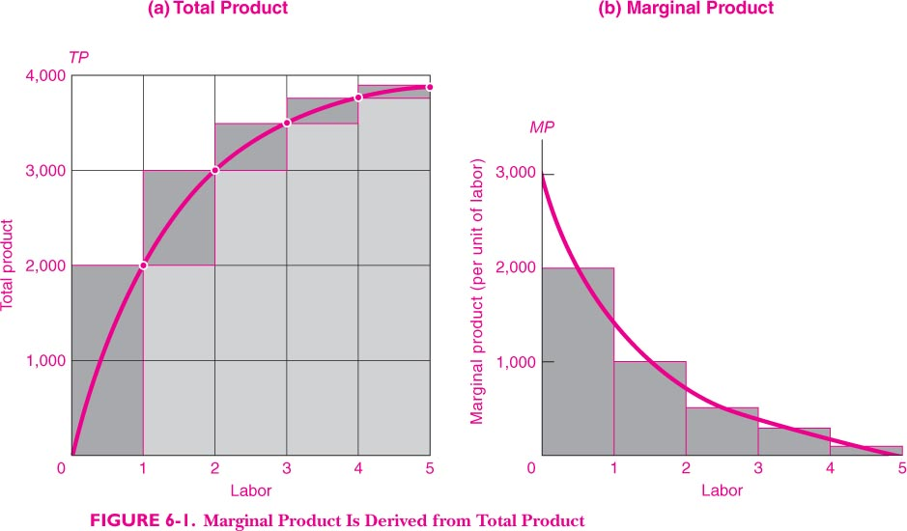
Total Product and Marginal Product

Slide 8
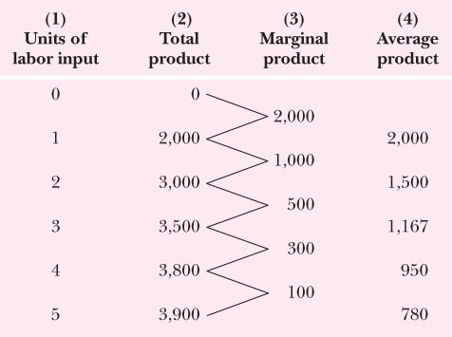
Total, Marginal and Average Product

Slide 9
The Law of Diminishing Returns
Marginal product declines in the short run due to the law of diminishing returns. If only the variable inputs is increased with some factors of production as fixed (as is expected in the short run), eventually marginal product of that factor will fall.

Slide 10
Production Function with 2 Variable Inputs
Equal Product Curves (Isoquants or iso product curves): indicate combinations of inputs which yield the same level of output.
Unlike Indifference curve, each production on each isoquant is measured cardinally. A higher isoquant depicts a higher level of output and the difference between the output associated with two or more isoquants can be stated in exact cardinal terms.
Isoquant map is a set of isoquants and it is a way of cataloguing the production possibilities.

Slide 11
Substitution among Inputs:
Marginal Rate of Technical Substitution (MRTS_{L-K}): is the amount by which the input of capital can be reduced when an extra unit of labour is used, keeping output level constant.
(MRTS_{L-K}) = -dK/dL It can be measured by the slope of the tangent to the isoquant at a given point.
Isoquants are downward-sloping and convex like ICs because, MRTS_{L-K} falls as move down along an isoquant. It implies limited productivity of an input. When labour is added in place of capital, productivity of labour falls. Similarly, when capital is substituted for labour, productivity of capital falls.
On an isoquant, MP_{L}*dL + MP_{K}*dK = 0
MP_{L}/MP_{K} = -dK/dL = (MRTS_{L-K})

Slide 12
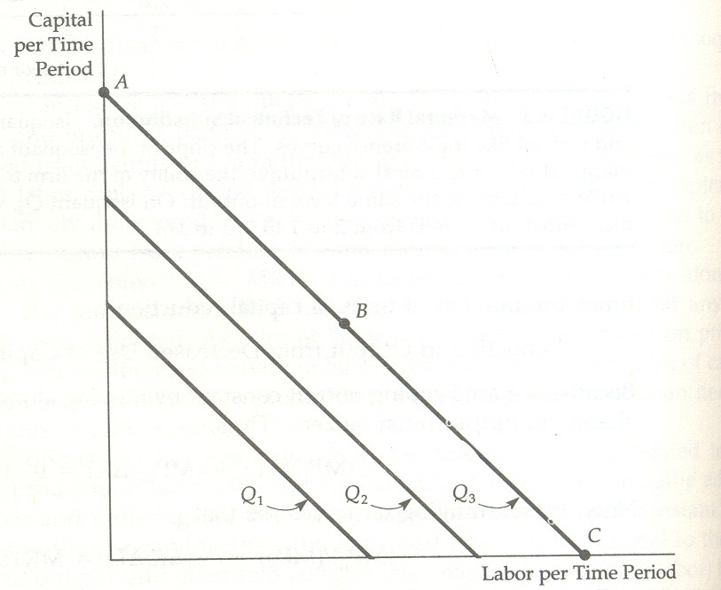
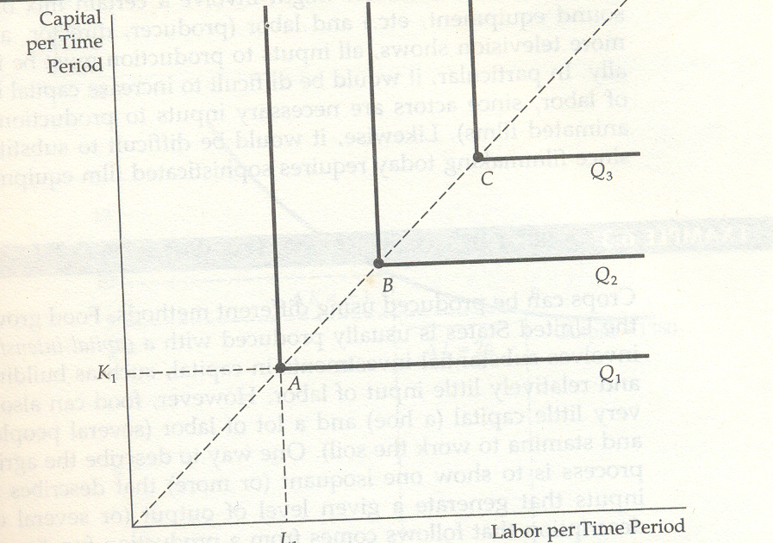
Two Special Cases of Prod Function
Fixed-proportion Prod Function: Isoquants are L shaped. Only one combination of L and K can be used for producing a given level of output. (MRTS_{L-K}) = 0.
Linear Production Function: When labour and capital are perfect substitutes. (MRTS_{L-K}) is constant on this production function.

Slide 13
Marginal Products and least-cost rule: Minimization of costs is part of the profit maximization problem. Least-cost rule is as follows: In order to produce a given level of output, a firm should employ inputs until it has equalized the marginal product per unit of money spent on each input.
MPA/PA = MPB/PB = MPC/PC = ....
A,B,C are variable inputs. Given the following
MPA PA MPB PB MPC PC
200 10 300 10 400 16
MPA/PA=20; MPB/PB=30; MPC/PC=25
the firm will first increase input of B and reduce input of A, this will result in decline in MPB and a rise in MPA. When all these ratios are equal, a firm enjoys the least-cost of production.

Slide 14
Least Cost Factor Combination for a Given Output:
Iso-cost line: Joins all points on which the total cost remains the same for given factor prices.
Suppose Total Cost is 100 and P_{L} = 5 and P_{K} = 10: producer can buy 20 units of L or 10 units of K. Least-cost tangency point reached when MP_{K}/MP_{L}=P_{K}/P_{L}=1/2

Slide 15
Returns to scale
Returns to scale is a long-run concept that reflects the response of total output to proportionate changes in all inputs.
Returns to Scale: Refers to the changes in output as all inputs are changed in the same proportion. Suppose we start from
Q₀ = f (L, K) and increase all inputs by 'n' times then, the new level of output Q₁ will be higher then Q₀:
Q₁ = f(nL, nK)

Slide 16
if Q₁/Q₀ = n then CRS; if Q₁/Q₀ > n then IRS
If Q₁/Q₀ < n then DRS
CRS: Output changes in the same proportion as the change in inputs. The scale of operation of the firm does not affect the productivity of its factors. E.g. Doubling of raw materials and labour in construction industry can give doubling of output.
IRS: When change in output is more than proportionate to change in inputs. This can arise as the larger operations allow managers and workers to specialize in their tasks and make use of sophisticated equipment. Automobile assembly line is a famous e.g. of IRS.

Slide 17
DRS: Ouput changes are proportionately less than the input changes. Management of a very large firm can become difficult due to organizational problems. Communication between workers and managers, coordination of tasks, impersonal nature of workplace may lead to decrease in productivity of factors as the scale of operation expands.
Diminishing marginal productivity (which is a short-run concept) can be consistent with increasing, decreasing, or constant returns to scale.

Slide 18
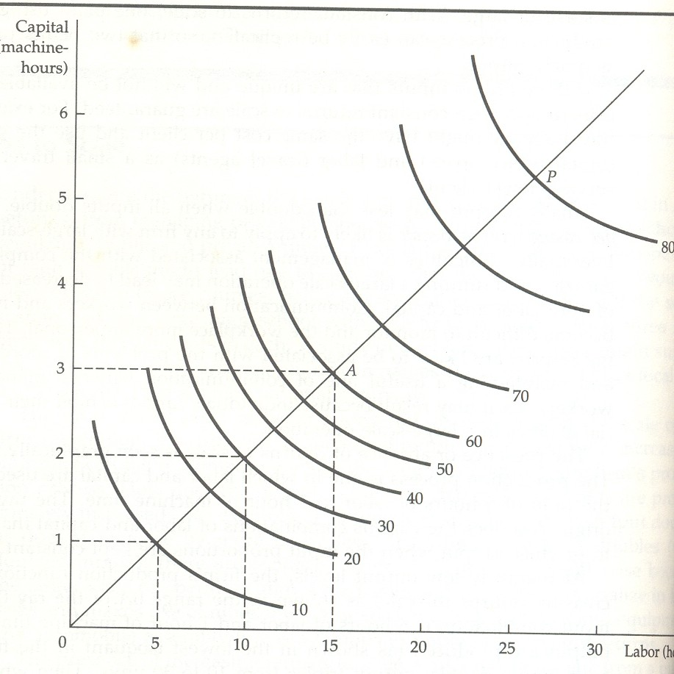
Returns to Scale
The distance (on the ray) between the isoquants depicting similar increments of output goes on decreasing in the case of IRS, increases in the case of DRS and remains constant for CRS.

Slide 19
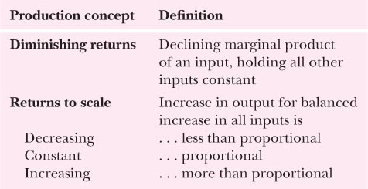
Concepts in Theory of Production

Slide 20
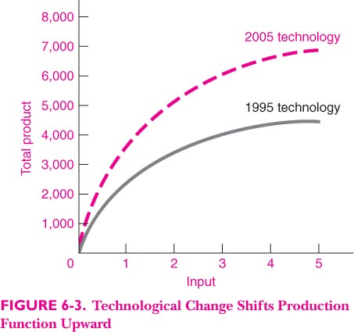
Role of Technology and Shifts in Production Function
When technological change occurs, the production function of the firm may shift. Process innovation leads to changes in production methods, while product innovation leads to the development of new products for the marketplace.

Slide 21
When technological change occurs, the production function of the firm may shift. Process innovation leads to changes in production methods, while product innovation leads to the development of new products for the marketplace.

Slide 23
Growth Accounting Approach
Two causes of change in productivity growth:
Due to increased inputs
Due to increased productivity
Partial vs Total Productivity Measure
Partial Productivity measures: AP and MP
Total Productivity measure: TFP or MFP
TFPG: Output growth that cannot be explained due to growth in inputs.
productivity growth measures the rate of growth in the level of productivity.

Slide 24
Business Organizations
Production has to be organized by firms because efficiency requires a minimum plant size and individual may not have the resources for establishing this minimum plant size.
Forms of business organizations

Slide 25
Business Organizations
Business establishments can be organized as:
Individual Proprietorship: Individual(s) raises resources and fully is responsible for profits/losses in the business. Owners' effort will be a key to the business success.
The Partnership: Two or more persons contribute to the capital of the business and share profits/losses and debts in proportion to the contribution of capital. Partnerships involve unlimited liability. In the case of liquidation of the company, if one or more partners cannot pay the debt, the remaining partner(s) will have the responsibility of debt repayment.

Slide 26
3. Corporations:
Resources are raised from a large number of shareholders who own the corporation in proportion to their shareholding and also share profits in the same proportion.
Publicly owned corporations are listed in the stock exchange.
Allow owners to limit their potential liability to the amount of their investment. Owners and managers are different groups of people. The owners are shareholders.

Slide 27
The managers have control over the operations of the firm. Critics point out that there are principal-agent problems, in which the agent (manager) does not always act in the best interest of the principal (owner) but in the agent’s own interests (such as maximizing pay, bonuses, and perks).

